Slide 1
Points and Vectors
Coordinates within 2D and 3D spaces
Programming – Maths for Games

Slide 2
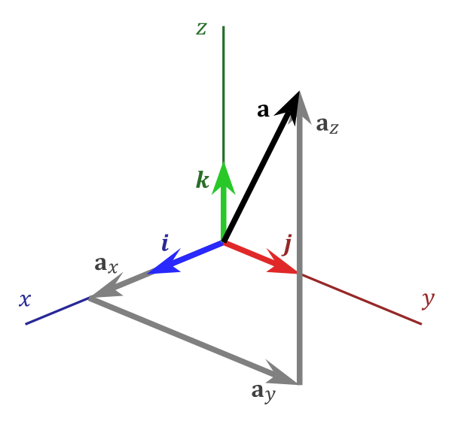
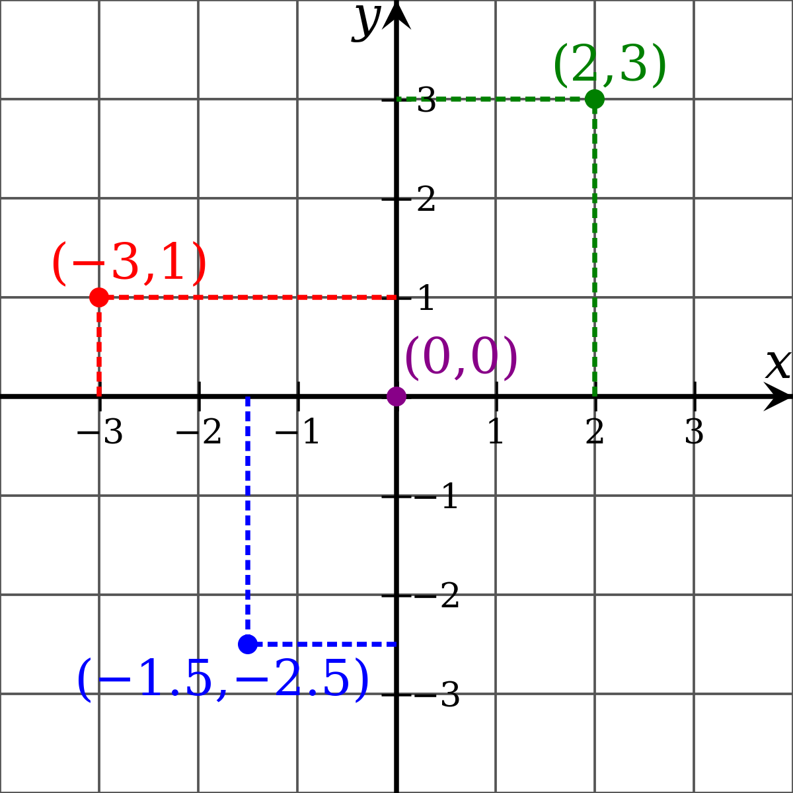
Contents
What are Points and Vectors?
Coordinate Spaces
1-Dimensional
2-Dimensional
3-Dimensional
Points
Vectors
Points and Vectors in Code

Slide 3
Points and Vectors
In an overly simplified way of explaining them…
A Point represents a location
No size, length, scale, volume, mass, etc
Can be moved, but can’t be rotated or scaled as it has no facing or size
A Vector represents a direction
Has a length and can be scaled
Can be rotated to face in a different direction, but can’t be moved as it isn’t a location
We can move a Point with a Vector by combining them
We can’t move a Point with a Point
We can combine two Vectors to make a new Vector

Slide 4
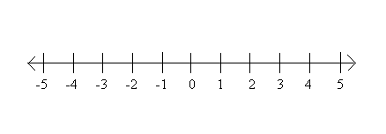
1-Dimensional Coordinates
A single number is represented by a value called a Scalar
A Scalar is located on a single axis often labelled X
A Point in 1-D is a single number
i.e. 3, or 4, or -2
A Vector represents a direction and length in that direction
i.e. +4, or -2, or +7

Slide 5
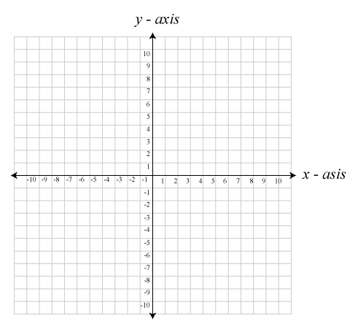


2-Dimensional Coordinates
2-Dimensions use Cartesian Coordinates on a plane known as the Cartesian Plane or the Number Plane
Comprised of two axes at right-angles to one another
X-axis and Y-axis
A location at 0,0 is called the Origin
A 2-D Point represents a location on the X,Y plane
Uses 2 coordinates, X and Y
A Vector represents a direction from the Origin in the 2 axis
Uses 2 coordinates, X and Y, that represents offsets in each axis
$$P=\left[\begin{matrix}x \\ y\end{matrix}\right]$$
$$V=\left[\begin{matrix}x \\ y\end{matrix}\right]$$

Slide 6
2-Dimensional Coordinates
-7, 6
7, 3
8, 2.5
-3.1, -10.1

Slide 7
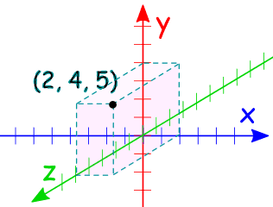


3-Dimensional Coordinates
3-D space is similar to 2-D space but with the addition of another axis
The Z-axis
In 3-D Cartesian space the Z-axis is perpendicular to the X and Y axes
Points in 3-D space have 3 coordinates, X, Y and Z
Vectors in 3-D space have 3 offsets from the origin in each axis, X, Y and Z
$$P=\left[\begin{matrix}x \\ y \\ z\end{matrix}\right]$$
$$V=\left[\begin{matrix}x \\ y \\ z\end{matrix}\right]$$

Slide 8







Points and Translation
The maths for Points doesn’t really change no matter how many dimensions we are using
A Point simply represents a location within that coordinate space
It has no size, scale, weight, or anything, it represents a location and that is all
However, we can Translate a Point by a Vector
Translation means to move something
We just combine the Point P’s coordinates with the Vector V’s coordinates to find a new Point
$P_{1}$= -7, 4
$P_{2}$= 8, 3
$V$ = 15, -1
$$P_{2}=P_{1}+V$$
$$P_{2}(x,y)=(P_{1}x+Vx,P_{1}y+Vy)$$
$$P_{2}(x,y)=(−7+15,4+−1)$$
$$P_{2}(x,y)=(8,3)$$

Slide 9






Points
We can also find the difference between two Points
The difference would be a Vector that we could combine with one Point to translate it to the other Point
To find the Vector that would translate from $P^{1}$ to $P^{2}$ we simply subtract $P^{1}$ from $P^{2}$
$P_{1}$= -7, 4
$P_{2}$= 8, 3
$$V=P_{2}−P_{1}$$
$V$= 15, -1
$$V\left(x,y\right)=(P_{2}x−P_{1}x,P_{2}y−P_{1}y)$$
$$V\left(x,y\right)=(8−−7, 3−4)$$
$$V\left(x,y\right)=(15, −1)$$

Slide 10



Vectors
A Vector is a geometric object that has a direction and length
The length is referred to as the Magnitude
We will look into the Magnitude further in another lesson
Vectors can’t be moved like a Point
It does not represent a location, so it can’t be moved to another location
Vectors can be scaled
We can change its length
To do this we can either multiply or divide the Vector by a Scalar value
As previously mentioned a Scalar is just a 1-dimensional value
$$V_{2}=V_{1}s$$
$$V_{2}=\frac{V_{1}}{s}$$
$$V_{2}=sV_{1}$$

Slide 11






Vector Scaling
$$V_{2}=\frac{V_{1}}{2}$$
$V_{1}$= 15, -1
$$V_{2}=0.5V_{1}$$
$V_{2}$= 7.5,-0.5
$$V_{2}(x,y)=(0.5V_{2}x,0.5V_{2}y)$$
$$V_{2}(x,y)=(15×0.5, −1×0.5)$$

Slide 12







Vector Addition and Subtraction
We can also combine two Vectors together to create a new Vector that combines both of the original Vectors’ offsets
We can also subtract Vectors if needed
$V_{2}$=8, 2.5
$V_{1}$=-3.1, -10.1
$$V_{3}=V_{1}+V_{2}$$
$$V_{3}(x,y)=(V_{1}x+V_{2}x,V_{1}y+V_{2}y)$$
$V_{3}$=4.9, -7.6
$$V_{3}(x,y)=(−3.1+8,−10.1+2.5)$$
$$V_{3}(x,y)=(4.9,−7.6)$$

Slide 13
Points and Vectors in Code
It is very common when writing mathematical code to combine Points and Vectors into a single class
Usually called a Vector, containing either float or double to represent X, Y and Z
Different versions exist for each dimension, such as Vector2 and Vector3, or vec2 and vec3
For 1-dimensions we typically just use a float or double to represent Scalars
Technically this means we have the ability to move Vectors and scale Points because they are within the same class
Technically we can do anything to Vectors and Points within our code that would not typically follow the rules of mathematics
Despite this you will never really have a use to move a Vector unless you combined two Vectors to make a 3rd, or never have a need to scale a Point unless the Point was also representing an actual Vector and you want to bring it closer to the Origin
class Vector2 {
public:
...
float x, y;
};
class Vector3 {
public:
...
float x, y, z;
};
struct vec2 {
float x, y;
};
struct vec3 {
float x, y, z;
};

Slide 14
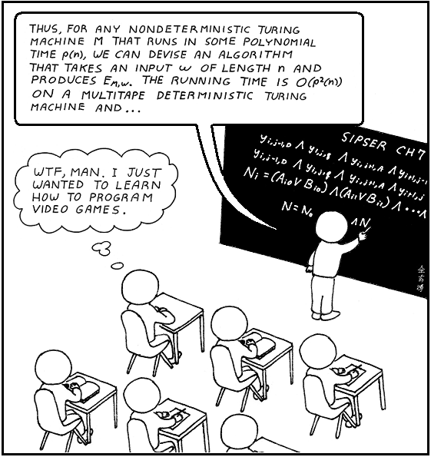
Summary
In code, Vectors can specify either a Point or a Vector
Typically called Vector2, Vector3, or vec2, vec3
In 1-dimension we simply use a float or double
We can Translate Points by Vectors
We can scale Vectors
We can also combine Vectors to make a new Vector that combines the offsets

Slide 15
Further Reading
Dunn, F, Parberry, I, 2011, 3D Math Primer For Graphics And Game Development, 2nd Edition, CRC Press
Lengyel, E, 2012, Mathematics for 3D Game Programming and Computer Graphics, 3rd Edition, CENGAGE Learning

